Slide 1

RAYALASEEMA UNIVERSITY COLLEGE OF ENGINEERING, KURNOOL in partial fulfillment of the requirements for the award of the degree of Bachelor of Technology in COMPUTER SCIENCE AND ENGINEERING

Slide 2
Presented By:
1.MAJJARI NAVEEN - 20RU1A0531
2.SHAIK NOORULLAH - 20RU1A0549
3.HARIJANA KRISHNAVENI - 21RU5A0505
4.SHAIK MOHAMMED SUFIAN - 20RU1A0547
Under the esteemed guidance of
Mr. V. SATISH KUMAR, M.Tech.,
Assistant professor(Ad hoc) & Coordinator.

Slide 3
TITLE OF THE PROJECT
ACADEMIC ADMINISTRATIVE PLATFORM

Slide 4
Abstract
In today’s world the management system is very important and essential for every system. This management system is an application-based system, having two applications developed, one for teachers to manage teacher details and another for students to mark their details. The system uses the powerful database management system, data retrieval and data manipulation

Slide 5
Existing System
Academic institutions often face challenges in managing student information efficiently and effectively. Traditional methods of student management involving manual paperwork, there area many small scale industries or colleges use pen and paper to keep a record which will lead to errors.

Slide 6
Proposed System
To address these challenges and improve student management, we propose the development and implementation of a comprehensive Student Management System (SMS). The SMS will serve as a centralized platform for managing all aspects of student information and interactions

Slide 7
Technologies Used
Web Technologies : Html, JavaScript, CSS
Server-side Technology : PHP
Web Server : Apache 2.4
Database : MySQL
PHP Version : JAVA 8

Slide 8
System Architecture
Student Management
Notice Board
Result Management
Academic Administration
Subject Management
Admin Management
Class Management

Slide 9
Administrator:
Invalid
Login Id
Password
Services
Administrator
Authorized
User
Login Id
Password
Login

Slide 10
Use case Diagrams

Slide 12
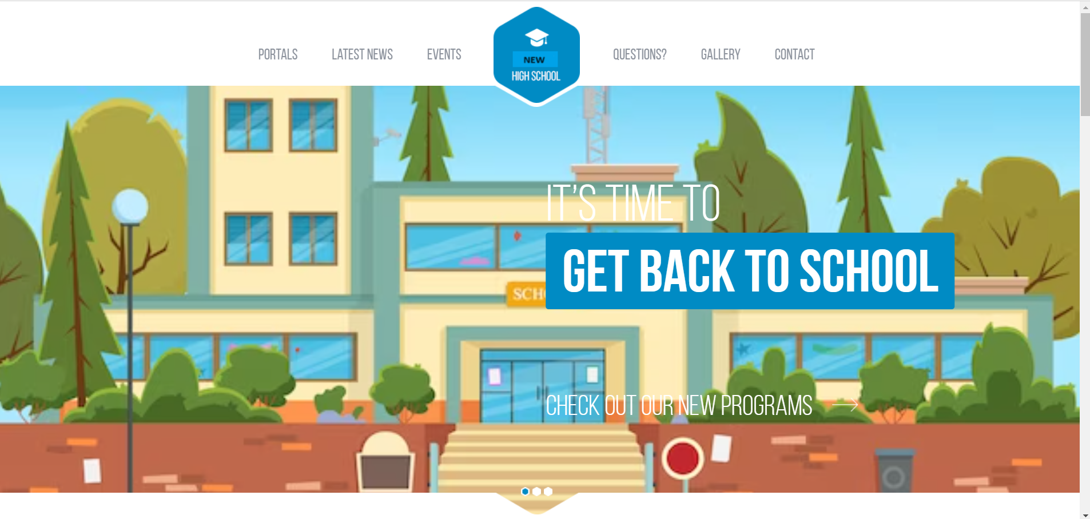
Sample Screenshots
Home Page:
Portals
Latest News
Events
Questions
Gallery
Contact

Slide 13
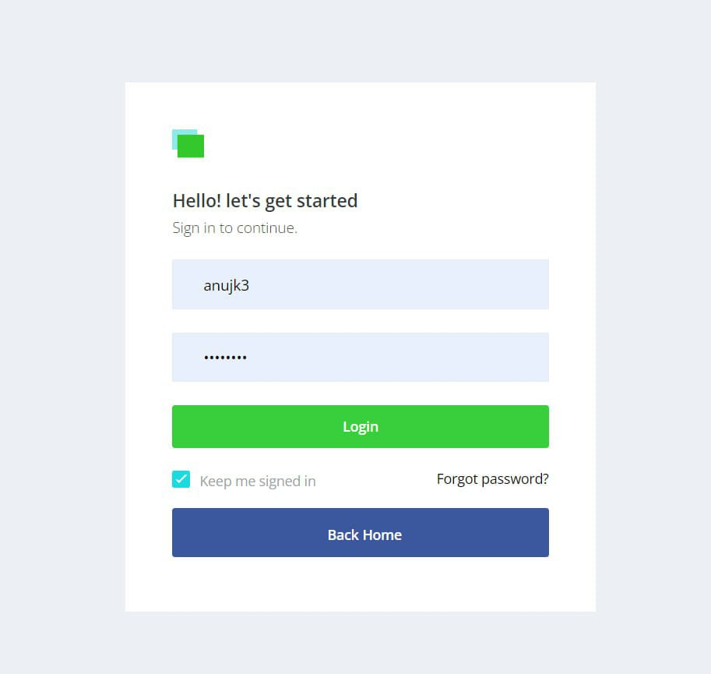
Admin Portal:
- Login
- Dashboard
- Class management
- Student management
- Notice board
- Reports & Search function

Slide 14
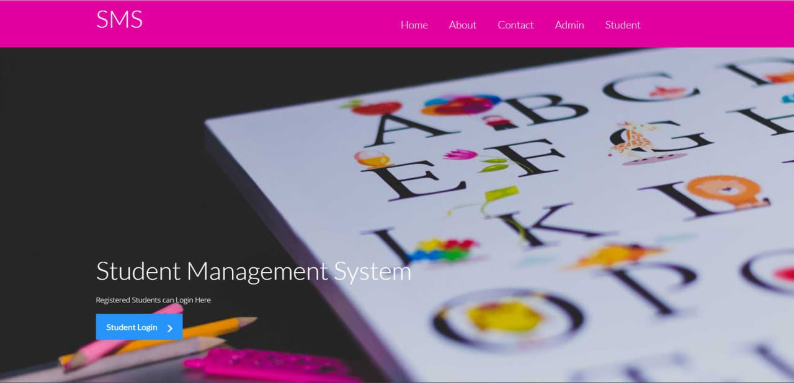
Student Management Portal:
About
Contact
Admin
Student Profile

Slide 15
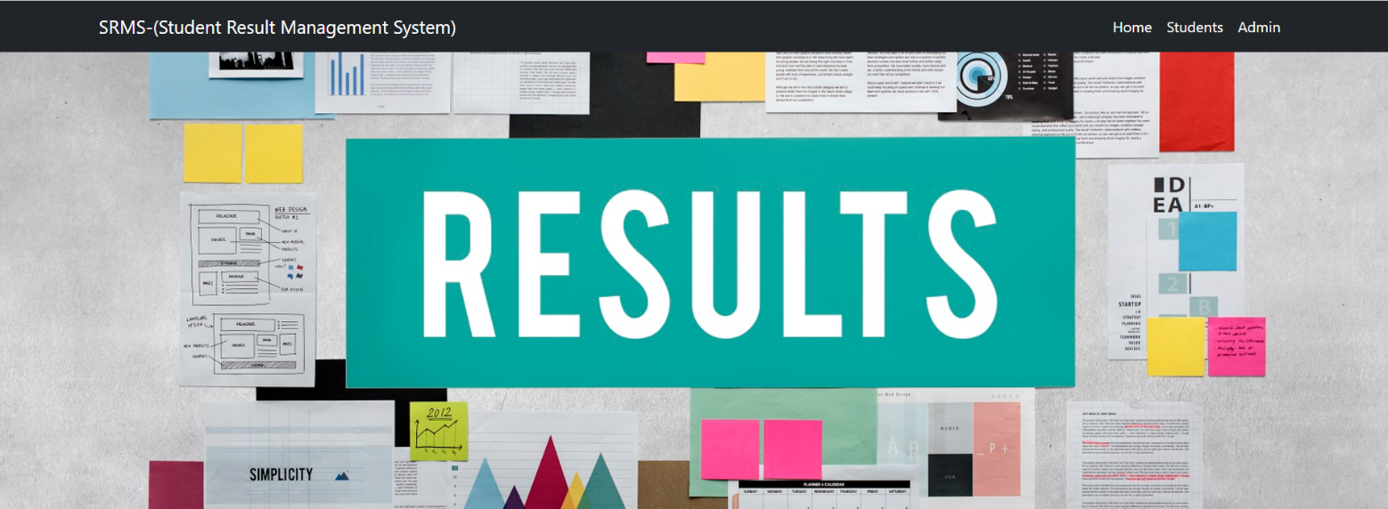
Result Portal:
Student Login
Admin Login

Slide 16
Conclusion
In conclusion, the implementation of a Student Management System (SMS) represents a transformative step towards enhancing educational administration, fostering collaboration, and improving outcomes for students, teachers, parents, and administrators alike.

Slide 17
Reference
Articles and Whitepapers:
My School: School Management System Based on Web https://www.studocu.com/en-gb/document/london-metropolitan-university/knowledge-in-policing/school-management-system-project-documen/11876052
Industry Websites:
Reference - School Management System https://www.dreamclass.io/what-is-school-management-software/
Platforms for school administration : https://www.sanomalearning.com/en/our-solutions/digital-platforms-for-administration-workflow/

Slide 18
Thank you

